Slide 1
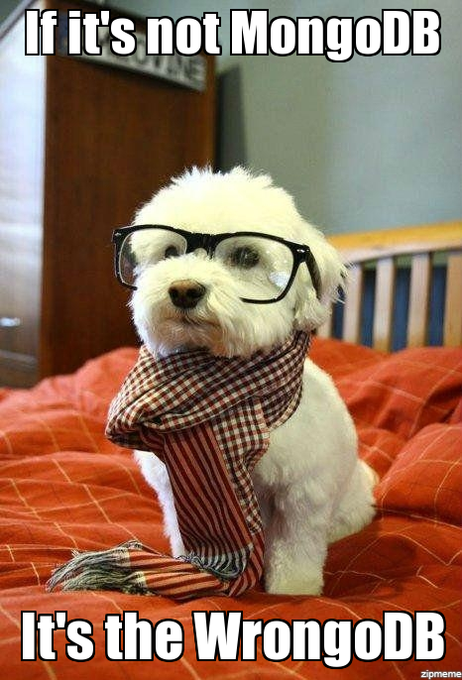

Slide 2
Intro to MongoDB Document Database
NoSQL Databases (DSO-553)
Prof: Arsames Qajar

Slide 3
Overview
Review Homework and questions
Introduce MongoDB
Practice Querying MongoDB
Feedback
Notes:
Here’s my history. Now lets start with a short history of why NoSQL sprung about - i.e. a short history of NoSQL so you can understand it in context

Slide 4

Document Family - Key Features
Flexible
{ }
Polymorphic
Schema-less
Rich QL and data structures
Notes:
Polymorphic --- not all documents have the same structure

Slide 5
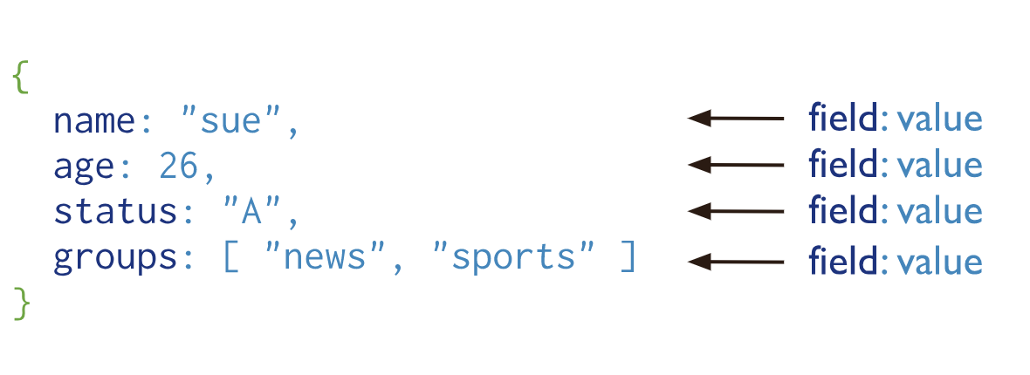
Document DB Structure - MongoDB
Notes:
Polymorphic --- not all documents have the same structure

Slide 6
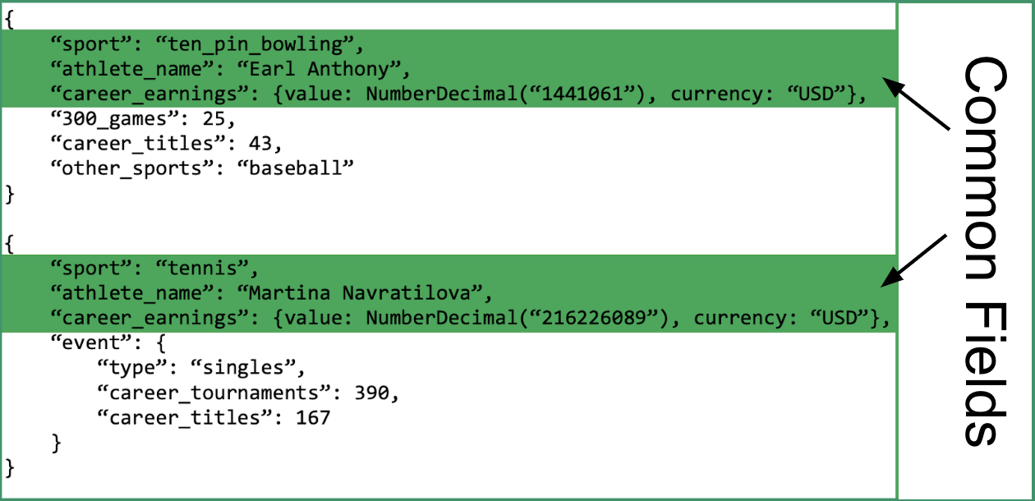
Document DB Structure - Polymorphic
Notes:
Polymorphic --- not all documents have the same structure
Query via dot notation
https://www.mongodb.com/blog/post/building-with-patterns-the-polymorphic-pattern

Slide 7
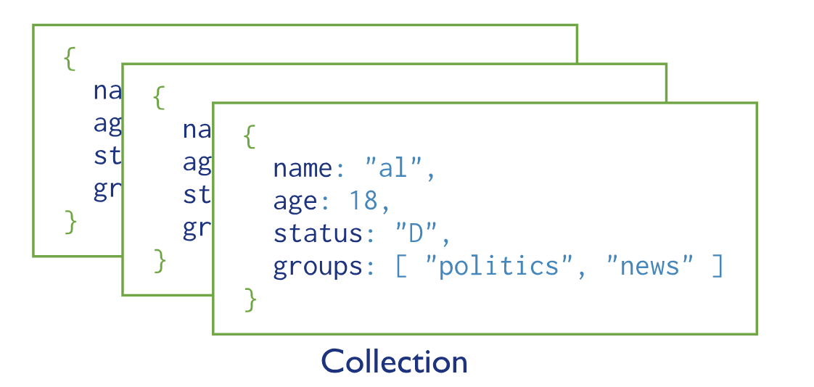
Document DB Structure - MongoDB
Notes:
Polymorphic --- not all documents have the same structure

Slide 8
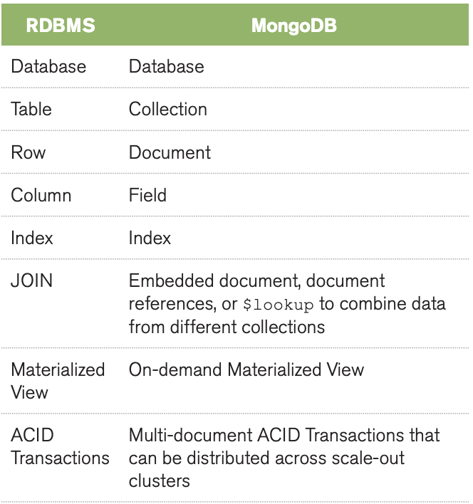
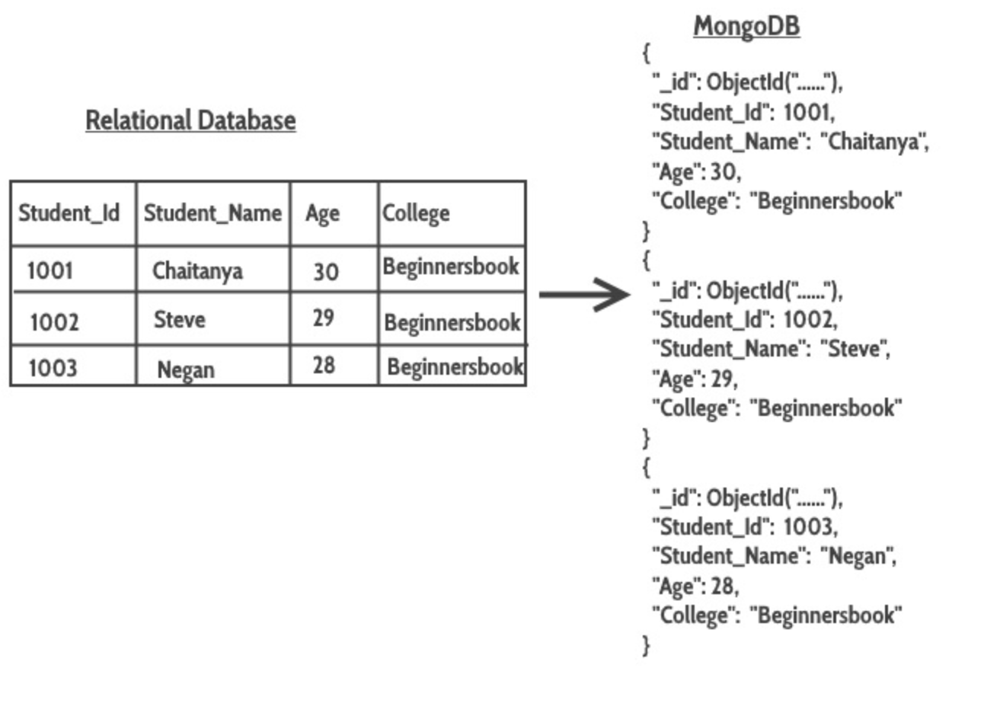
Document DB Structure and Relational Comp
Notes:
Polymorphic --- not all documents have the same structure

Slide 9
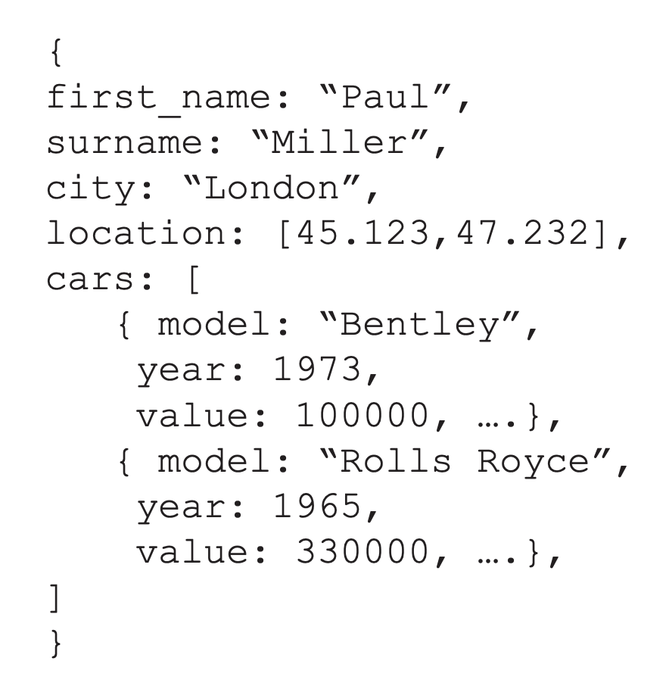
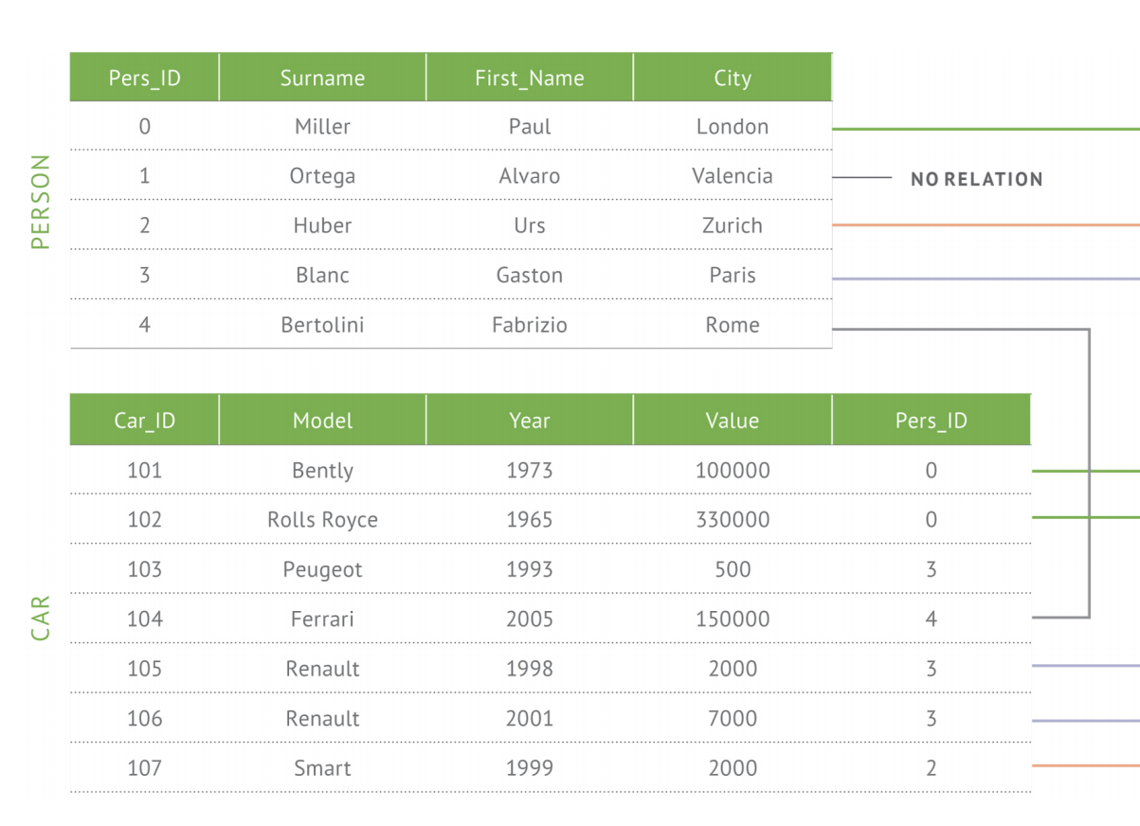
Document DB Structure and Relational Comp
MongoDB
Relational/SQL database
Notes:
Polymorphic --- not all documents have the same structure

Slide 10
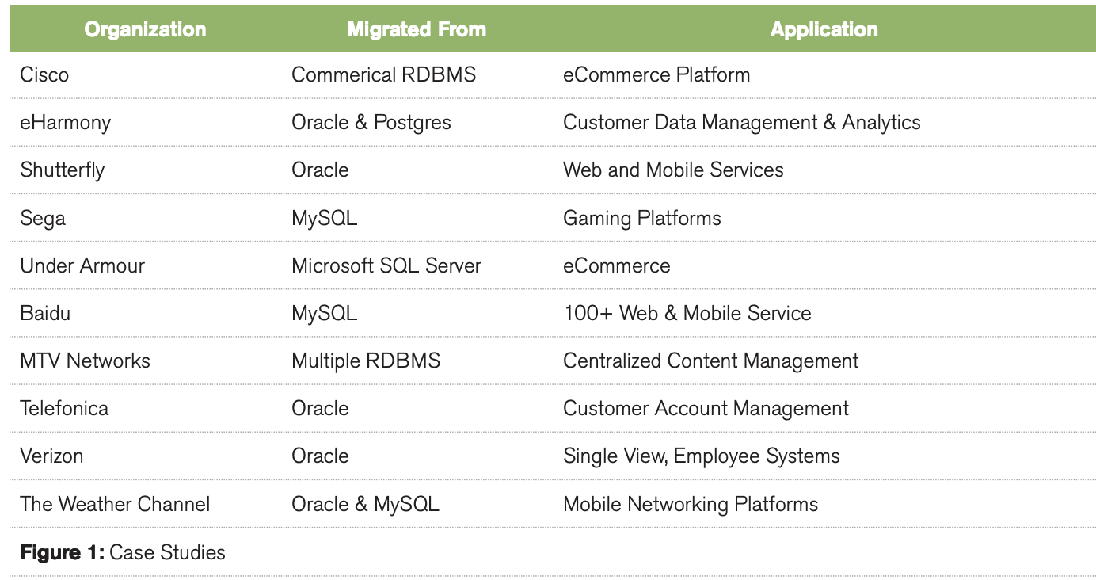
MongoDB Case Studies
Notes:
Polymorphic --- not all documents have the same structure

Slide 11
Intro to Querying in MongoDB
Any Questions?

Slide 12
Open up your Jupyter Notebook, MongoDB installed
Notes:
See reference - https://docs.mongodb.com/v3.2/reference/operator/aggregation-comparison/

Slide 13
Reference

Slide 14
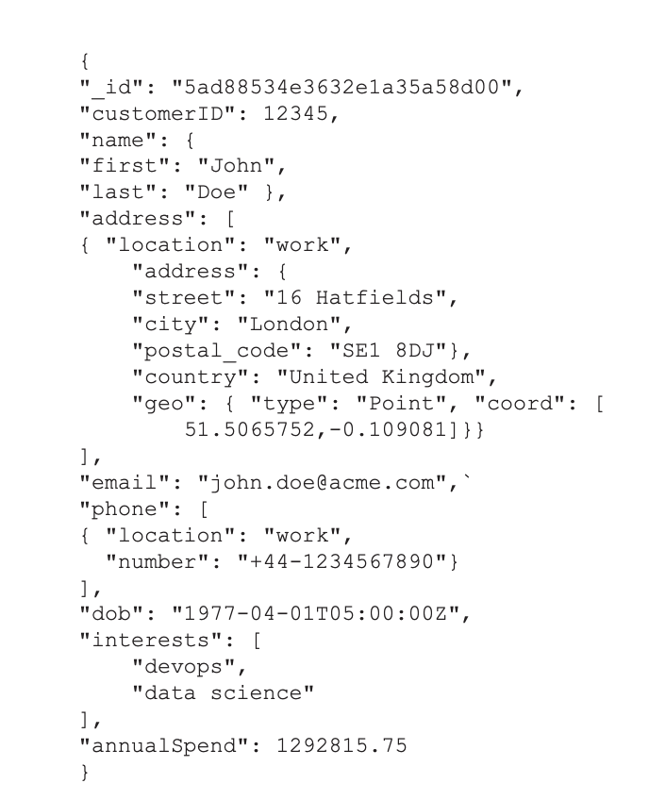
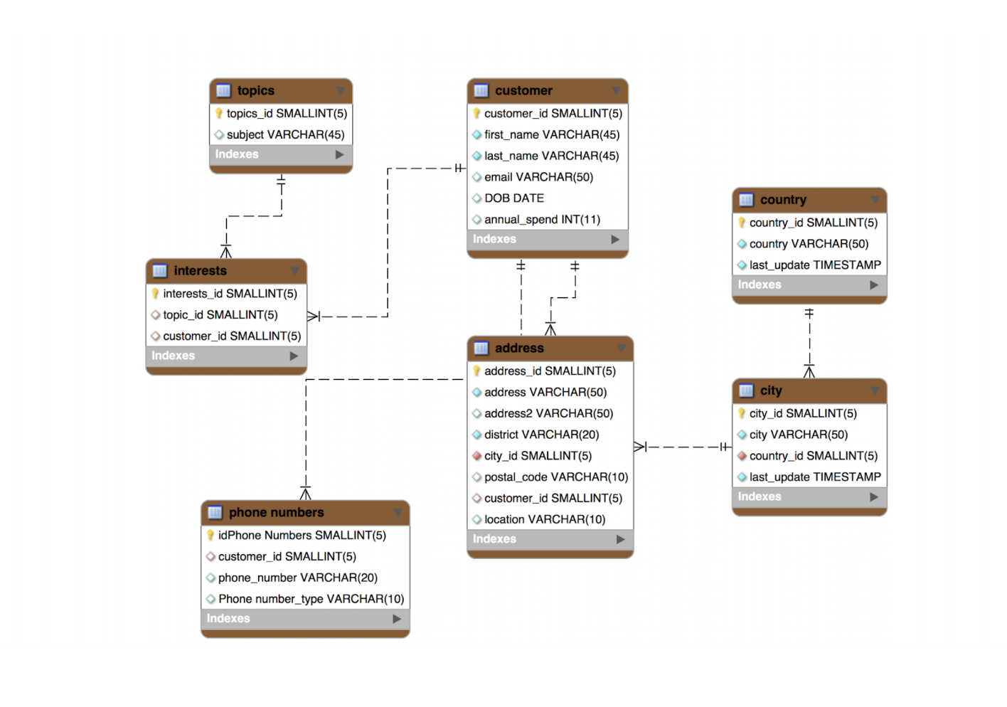
Document DB Structure and Relational Comp
MongoDB
Relational/SQL database
Notes:
Polymorphic --- not all documents have the same structure

